Slide 1
The parsed and the curious
PerlCon 2019
Rīga, Latvia
Carl Mäsak

Slide 2
Quick calibration
raise your hand if you can raise your hand
can’t or won’t

Slide 3
Time to Epimenides paradox: 19 seconds
that escalated quickly

Slide 4
S E N D + M O R E --------- M O N E Y
9 × 8 × 7 × 6 × 5 × 4 × 3 × 2

Slide 5
Search is for suckers
already knowing the answer
deep thought
failure
search
sucks
rocks

Slide 6
S E N D + M O R E --------- M O N E Y
C₃
C₂
C₁
Y = D + E
R = E – N – C₁
O = N – E – C₂
M = O – S – C₃

Slide 7
S E N D + M O R E --------- M O N E Y

Slide 8
search
my digits = [0, 1, 2, 3, 4, 5, 6, 7, 8, 9];
for digits -> D {
for digits -> E {
if E != D && (my Y = (D + E) % 10) != D && Y != E {
for digits -> N {
if N != D && N != E && N != Y && (my R = (E - N - (my C_1 =
(D + E) div 10)) % 10) != D && R != E && R != Y && R != N
&& (my O = (N - E - (my C_2 = (C_1 + N + R) div 10)) % 10)
!= D && O != E && O != Y && O != N && O != R {
for digits -> S {
if S != 0 && S != D && S != E && S != Y && S != N
&& S != R && S != O && (my M = (O - S - (my C_3 =
(C_2 + E + O) div 10)) % 10) != 0 && M != D
&& M != E && M != Y && M != N && M != R && M != O
&& M != S && C_3 + S + M == 10 * M + O {
say(S, E, N, D, "+", M, O, R, E, "=", M, O, N, E, Y);
} } } } } } }
constraint propagation
sorry ☹

Slide 9
S E N D + M O R E --------- M O N E Y

Slide 10
Moral: we can do a lot at compile time
Taking the constraints from the problem and playing around with them is a lot more powerful than just spitting out code to do the search.
The trick: use the abstractions to generate better code

Slide 11
Hi, I’m masak
I’m a Perl 6 userspace explorer
Programming language historian
Hobbies:
Programming
Math, music
Books
Beer (ales and stouts, mostly)
Laundry night

Slide 12
The things I like that got me here today
Nomic – a game where a move means changing the rules
GGE – a grammar engine written in Perl 6
YAPSI – a Perl 6 implementation in pure Perl 6
ipso – a metacircular Lisp evaluator
Quines – programs that print themselves
Autopuns – jokes that exploit the use/mention distinction
Fractals – they’re just cool, and contain themselves
Self-reference in general – this talk is really about itself, for example

Slide 13
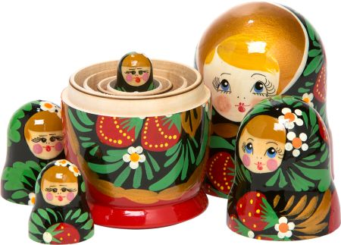

Russian dolls
I hate матрешки!
They’re so full of themselves!

Slide 14
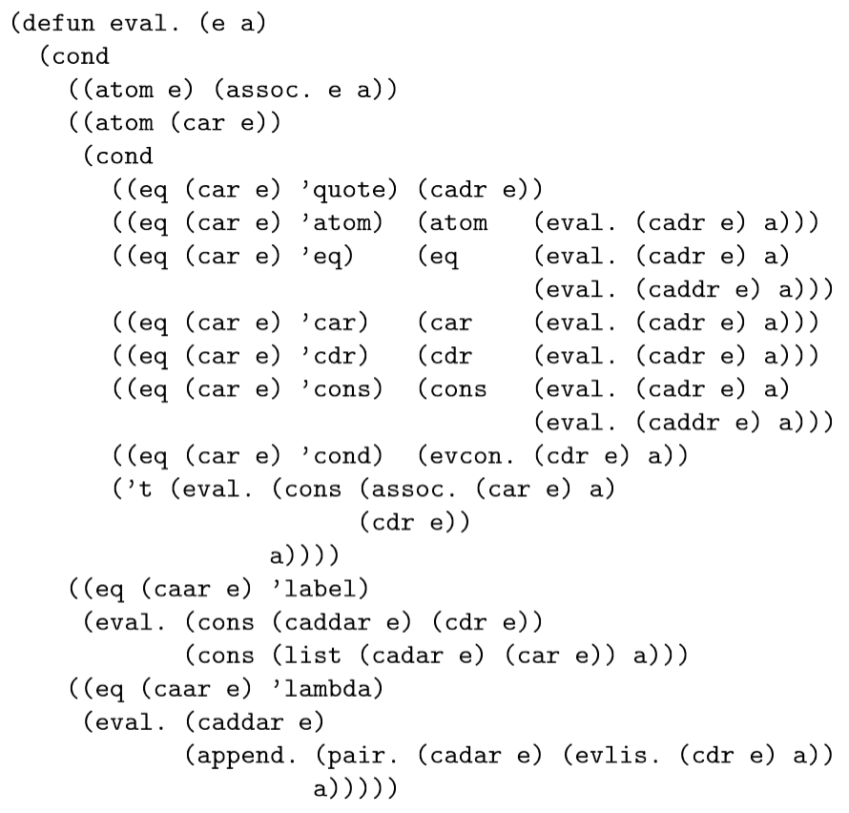
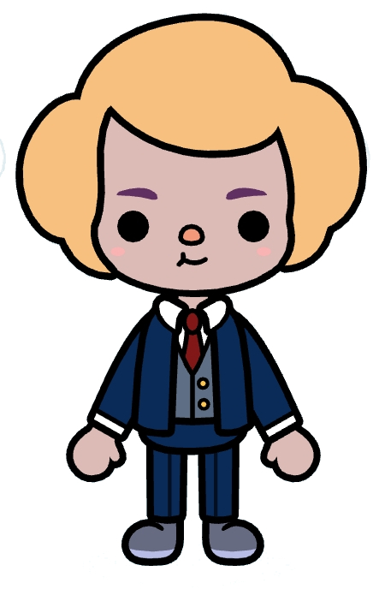
“Maxwell’s Equations of software”
– Alan Kay
Holy McCarthy!
That’s so elegant…
Lisp Metacircular
Evaluator

Slide 15
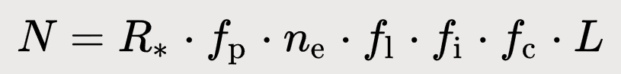
Drake equation
“Where is everybody?”
signals lifetime
signals
intelligent life
actual life
support for life
planets
stars

Slide 16
The Great Filter
Assuming Drake’s equation is a good model, the reason we’re seemingly alone in the universe is that one factor is very low
(Well, maybe several are somewhat low together, but that’s statistically unlikely)
Which one is it?
Is it behind us or ahead of us?
Behind us? Phew!
Ahead of us? Global warming, nuclear threat, civilizations being short-lived, The Dark Forest…

Slide 17
What’s a macro
what the talk is really about

Slide 18
say we want to swap two values
my a = 1;
my b = 2;
#
# swap `a` and `b` somehow
#
say(a); # 2
say(b); # 1

Slide 19
we can do this; bam, done
my a = 1;
my b = 2;
my t = a;
a = b;
b = t;
say(a); # 2
say(b); # 1

Slide 20
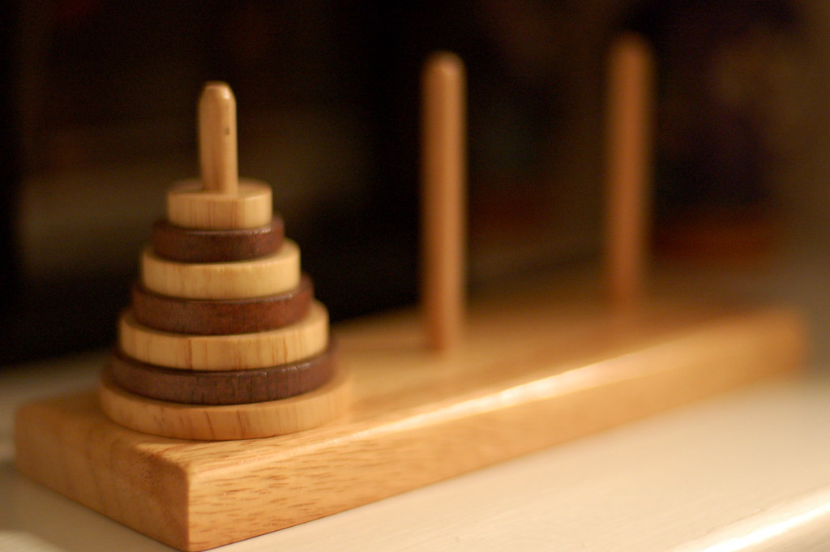
flickr mszeto by-nd

Slide 21
this won’t work as intended
func swap(x, y) {
my t = x;
x = y;
y = t;
}
my a = 1;
my b = 2;
swap(a, b);
say(a); # 1
say(b); # 2
pass by value

Slide 22
but a macro works
macro swap(x, y) {
return quasi {
my t = x;
x = y;
y = t;
};
}
my a = 1;
my b = 2;
swap(a, b);
say(a); # 2
say(b); # 1

Slide 23
oops! forgot all the unquotes
macro swap(x, y) {
return quasi {
my t = {{{x}}};
{{{x}}} = {{{y}}};
{{{y}}} = t;
};
}
my a = 1;
my b = 2;
swap(a, b);
say(a); # 2
say(b); # 1

Slide 24
summary, for now:
Macros run at compile time
They take code/AST as arguments
They return code/AST
They can do some things functions can’t
Perhaps most importantly, macros are abstractions, for us to hide implementation details inside.

Slide 25
Hard-won insight #1

Slide 26
The metasyntactic identifier for macros
…should be moo.
Just as the one for functions is foo.
I’ll leave it to wiser minds to decide what the one corresponding to bar should be.
macro moo(…) {
# …
}

Slide 27
The lead-up to 007
what the talk is really about

Slide 28
Another audience poll
but first,
raise your hand if you’re also programming in languages besides Perl 5 or Perl 6

Slide 29
Reading the Apocalypses and Synopses
Used liberally throughout as a “pixie dust” mechanism.
S03: “In a pinch you can define a macro…”
S04: “(You could write a macro that violates this, but resist the urge)”
Also S04: (Toyingly declaring if, while, and BEGIN as macros.)
S06: “The temp macro…”
S09: “You are, of course, free to use macros or type declarations to associate additional names…”
S11: “Tweaks can be specified either directly in your code as macros and such, or such definitions may be imported from a package.”

Slide 30
I realized I must do macros
In YAPC::Europe in Rīga in 2011, I suddenly realized that the only one who would ever implement macros in Perl 6 was someone as obsessed with them as I was.
Well, am.

Slide 31
Macro grant, and eventually 007
I applied for a Hague grant with TPF.
I got through half of that grant, and it went quite well, actually.
But then I realized this was all much deeper and harder than I had planned for, and I needed a “language lab” to quickly iterate on ideas.
In late 2014, the language 007 saw the light of day.

Slide 32
007 is the love child of Perl and Python
Perl 6
Blocks and semicolons
Implicit typecasts
Implicit returns
Variable declarations
User-defined new operators
Macros
Python
No sigils
Explicit typecasts
No multi subs
The none value
(With some JavaScript and TypeScript design decisions thrown in as a tiebreaker)

Slide 33
example: factorial
func postfix:<!>(N) {
my product = 1;
my n = 2;
while n <= N {
product = product * n;
n = n + 1;
}
return product;
}
say(20!);

Slide 34
example: factorial (nicer)
import * from syntax.op.reduce;
import * from range;
func postfix:<!>(N) {
return [*](...(2..N));
}
say(20!);

Slide 35
example: increment
macro postfix:<++>(term) {
return quasi {
my oldval = {{{term}}};
{{{term}}} = {{{term}}} + 1;
oldval;
};
}
my value = 7;
say(value++); # 7
say(value); # 8

Slide 36
Rough timeline of the project
macro hygiene
007
created
user-defined operators
my term
use Travis
now
regexes
Bool
2015
2016
2017
2018
2019

Slide 37
A warm thank you to these people
sergot – for helping to hack on a lot of the features
vendethiel – for much LISP explanation and regexes hacking
raiph – for providing much-needed boundary-pushing on quasi and unquote syntax discussion
szabgab – for sending the patch that enabled Travis for the project

Slide 38
Hard-won insight #2

Slide 39
Lexical lookup is fantastic
Not just because “yay, these names are not global!”
But also because there’s something inherently powerful in letting a name be bound only inside a certain (static) scope
There’s some mystical static/dynamic interplay going on here
Python and Ruby people are really missing out (no my declarations)
Common doofus mistake I made: using a string name instead of lexical lookup
Switching to lexical lookup, things typically got easier, and cleaner

Slide 40
What’s a compiler
what the talk is really really about

Slide 41
To many people, the compiler is a stern, unforgiving judge of syntax…

Slide 42

THOU SHALT NOT PARSE!

Slide 43
BEGIN block
eval
compile time
(static)
run time
(dynamic)

Slide 44
”Compile”: meaning
to put together
to make
to gather together
Etymology: 1275–1325; Middle English < Latin compīlāre to rob, pillage, steal from another writer, equivalent to com- + -pīlāre, perhaps akin to pīla column, pier, pile, pīlāre to fix firmly, plant (hence, pile up, accumulate)

Slide 45
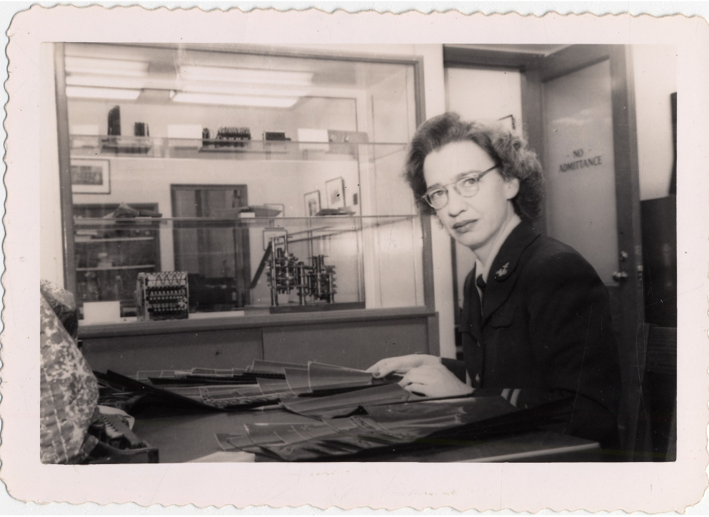
rear admiral
Grace Hopper
Built the first compiler
Pioneered the term “bug”
Carried nanoseconds in her bag for educational purposes
Would code circles around you

Slide 46
Programmers and coders
Back in Hopper’s time, there were
Programmers, more like today’s architects, working with models and flow charts.
Coders, domain experts for a certain machine, knew all the opcode numbers by heart, knew how to write fast code.
The coders really didn’t like the idea of a compiler. A program doing their job? You’ll never guess what happened next…

Slide 47
When they go low, you go high — Grace Hopper
become superhumanly good at generating target code
focus on higher abstractions
compilers
— Michelle Obama

Slide 48
Ada Lovelace and abstractions
“[The Analytical Engine] might act upon other things besides number, were objects found whose mutual fundamental relations could be expressed by those of the abstract science of operations, and which should be also susceptible of adaptations to the action of the operating notation and mechanism of the engine...Supposing, for instance, that the fundamental relations of pitched sounds in the science of harmony and of musical composition were susceptible of such expression and adaptations, the engine might compose elaborate and scientific pieces of music of any degree of complexity or extent.”
— Ada Lovelace

Slide 49
Abstractions are lies
If you’re a programmer, you’re a professional liar.
Actually, the tower of abstractions is so high, we’re more like professional mythomaniacs.

Slide 50
parse
optimize
generate
compile time
run time

Slide 51
Macro hygiene
macro surgeons must always wash their hands before the procedure

Slide 52
Closures and the Expectation of Sanity
If developer A uses a variable inside of a subroutine, and developer B uses the same variable name somewhere else…
sub foo(…) {
my t = 1;
}
my t = 2; foo();
…they will have no fear that their use of those variables will somehow collide.

Slide 53
Hygiene is just the Expectation of Sanity
If we apply the same expectation to macros, we get what’s called macro hygiene.
macro moo(…) {
quasi { my t = 1 };
}
my t = 2; moo();
Of course, now it’s actually a bit tricky, since macros copy code around, including variables, which might collide in the same scope.

Slide 54
How to solve macro hygiene
It took me years to stumble over the right solution to this, but 007 finally implements it.
The solution involves something that I still don’t have a good term for, but let’s call them locked-in variables.

Slide 55
Builtins and locked-in variables
Name lookup aims to find the memory location where a name is stored, and usually the value in that location.
This gets tricky/interesting because, although the declaration and its usages are all completely static…
…the lookup itself needs to be dynamic.
(Why? Basically because of stack frames. Every new call to a routine allocates new memory locations.)
But! Not all names are alike. Think of builtins. They are unique.
Doing lookup on them is wasteful. We can “lock in” on them.

Slide 56
Locking in variables gives us hygiene
When a quasi refers to variables outside of itself, doing the usual lexical lookup on these is fraught…
…because that code is going to end up being inserted somewhere else in the program.
But! We can lock in those variables, just as with builtins.
That only works if they’re unique just like builtins, though.
…which they are, for the same reason you can’t step into the same river twice. Every time we call the macro, it’s with a new stack frame and fresh memory locations. Phew!

Slide 57
The Single Evaluation Rule
It’s generally not a good idea to unquote code multiple times.
macro swap(x, y) {
return quasi {
my t = {{{x}}};
{{{x}}} = {{{y}}};
{{{y}}} = t;
};
}
macro postfix:<++>(term) {
return quasi {
my oldval = {{{term}}};
{{{term}}} =
{{{term}}} + 1;
oldval;
};
}

Slide 58
Actually, three things are hard
Remembering to unquote
The Single Evaluation Rule
Dealing with quasis at all
Fortunately, we have a feature that will let us write simple code and that will generate tricky-but-correct code for us…
…yep, you guessed it.

Slide 59
Succinct macros
Macros without all the hassle
@succinct
macro swap(x, y) {
my t = x;
x = y;
y = t;
}
@succinct
macro postfix:<++>(term) {
my oldval = term;
term = term + 1;
oldval;
}

Slide 60
Composition
what the talk is really really about

Slide 61
Macros and composition
One of the things to strive for with language features is that they compose well with other parts of the language.
Macros are new language features. So they should compose.
Composition is the true goal of a programmer.

Slide 62
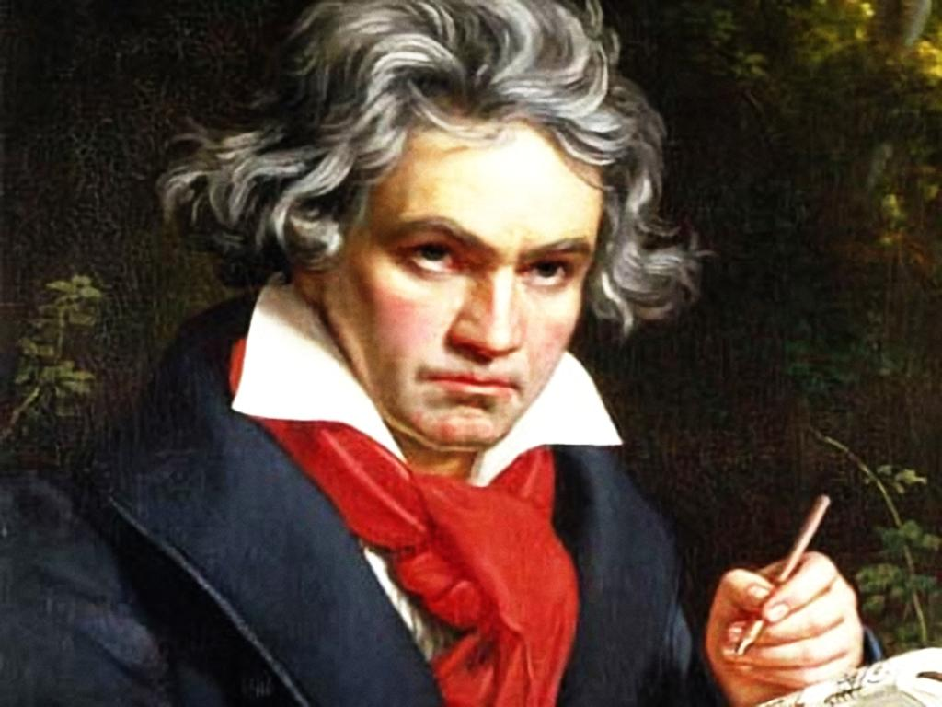
YOU’RE A COMPOSER

Slide 63
this could be your next business card!
J. A. Perl Hacker
Composer of Cybernetic Masterworks

Slide 64
Examples: safe navigation
foo?.bar?[0]?.baz;

Slide 65
Examples: exists and delete
exists foo.bar[0]["baz"];
delete foo.bar[0]["baz"];
exists foo?.bar?[0]?["baz"];
delete foo?.bar?[0]?["baz"];

Slide 66
Unintended consequences
uh oh

Slide 67


You can’t do that!
Oh yeah?
Hold my beer…

Slide 68
Returning from the default of a parameter
sub getset($obj, $value = return $obj->{value}) {
$obj->{value} = $value;
}
# desugars to…
sub getset($obj, $value?) {
$value //= return $obj->{value};
$obj->{value} = $value;
}

Slide 69
Hard-won insight #3

Slide 70
The thing in a quasi is not code… yet
It looks like 007-plus-quasis and thus “a kind of 007”
(Or “a kind of Perl 6”, or what have you)
But that’s wrong wrong wrong
It’s a metalanguage for building 007/Perl 6 code
The unquotes are holes, non-code, negative space
The unquotes are not part of the AST
The quasi is not an AST

Slide 71
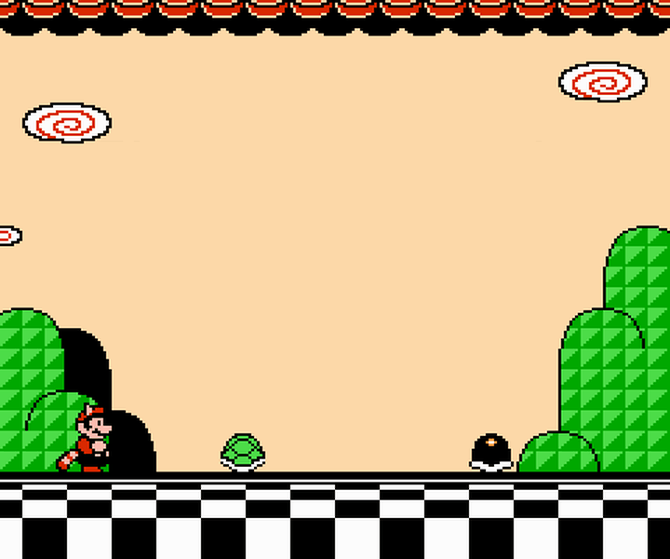
Autopuns!
bonus round!

Slide 72
There are three things I always forget:
Names, faces, and…
the third I can’t remember

Slide 73
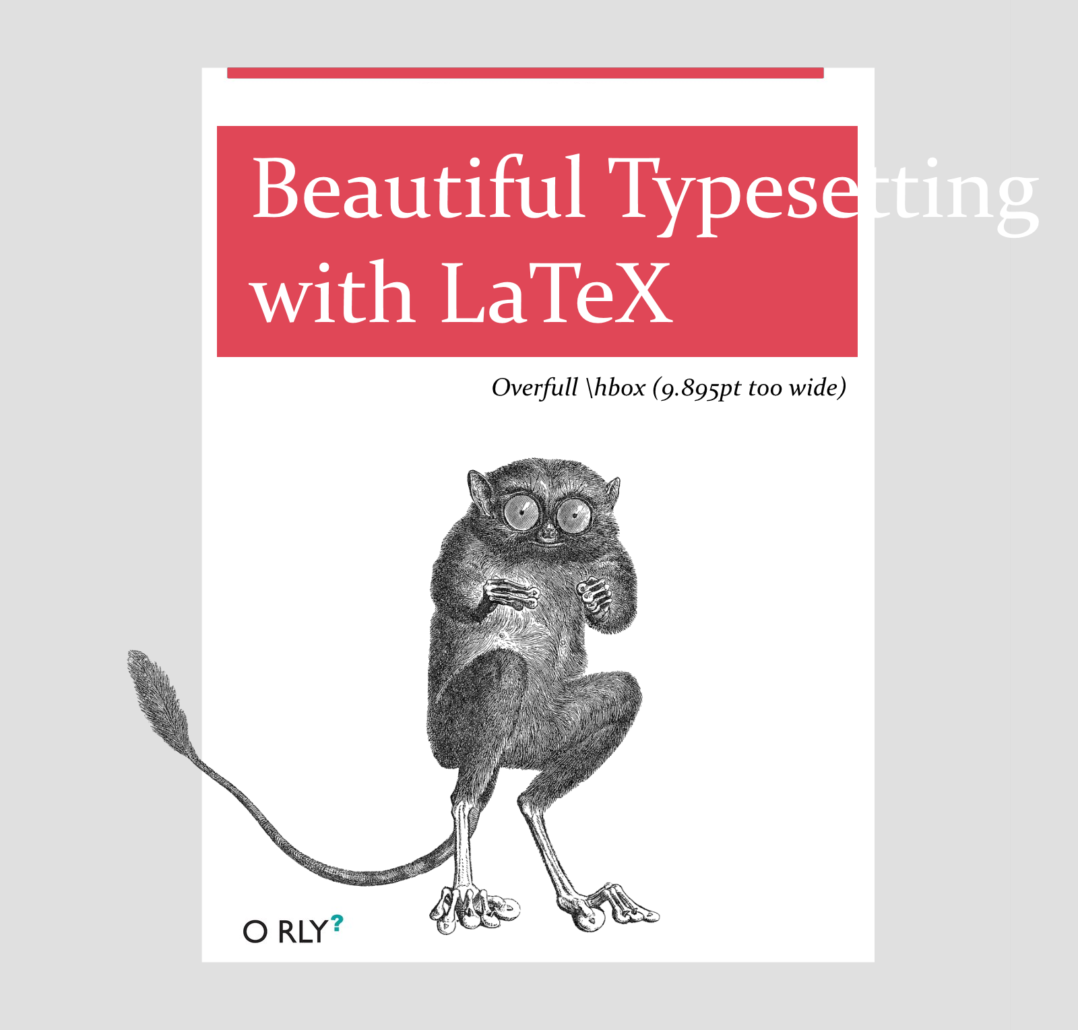

Slide 74
Not only is my short-term memory horrible
but so is my short-term memory

Slide 75
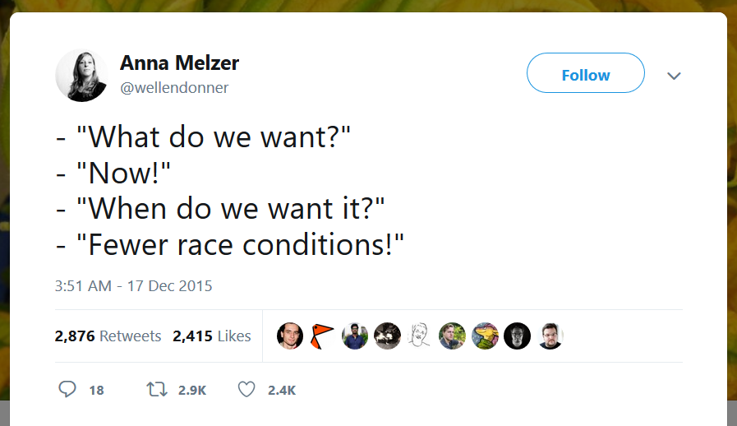

Slide 76
If I had to describe myself in one word, it would be:
“Bad at following directions”
— moritz

Slide 77
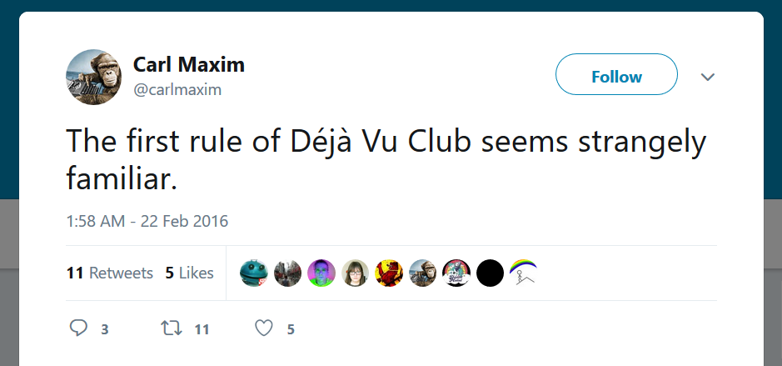

Slide 78
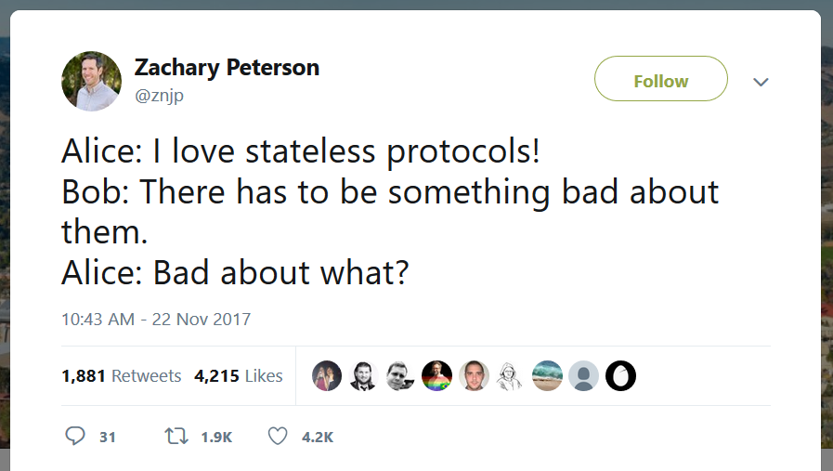

Slide 79
A Freudian slip is when you mean one thing
but say your mother

Slide 80
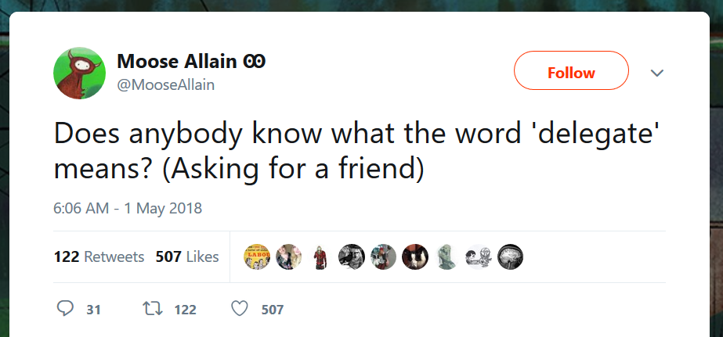

Slide 81
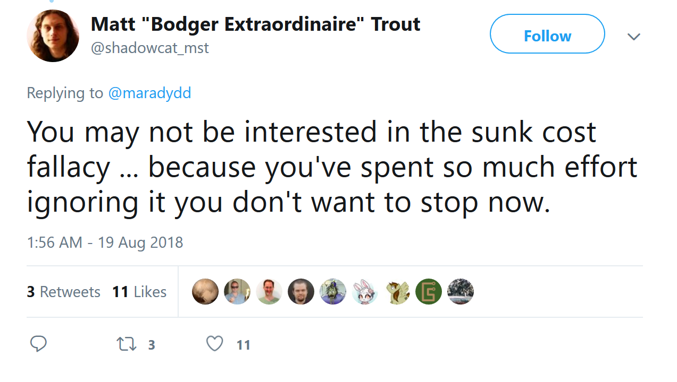

Slide 82
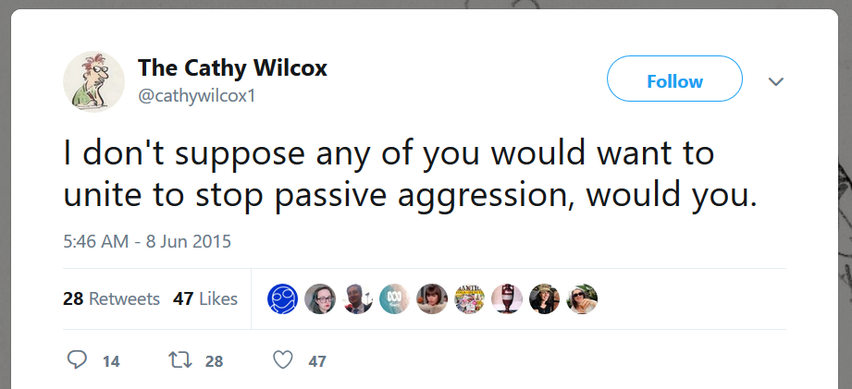

Slide 83
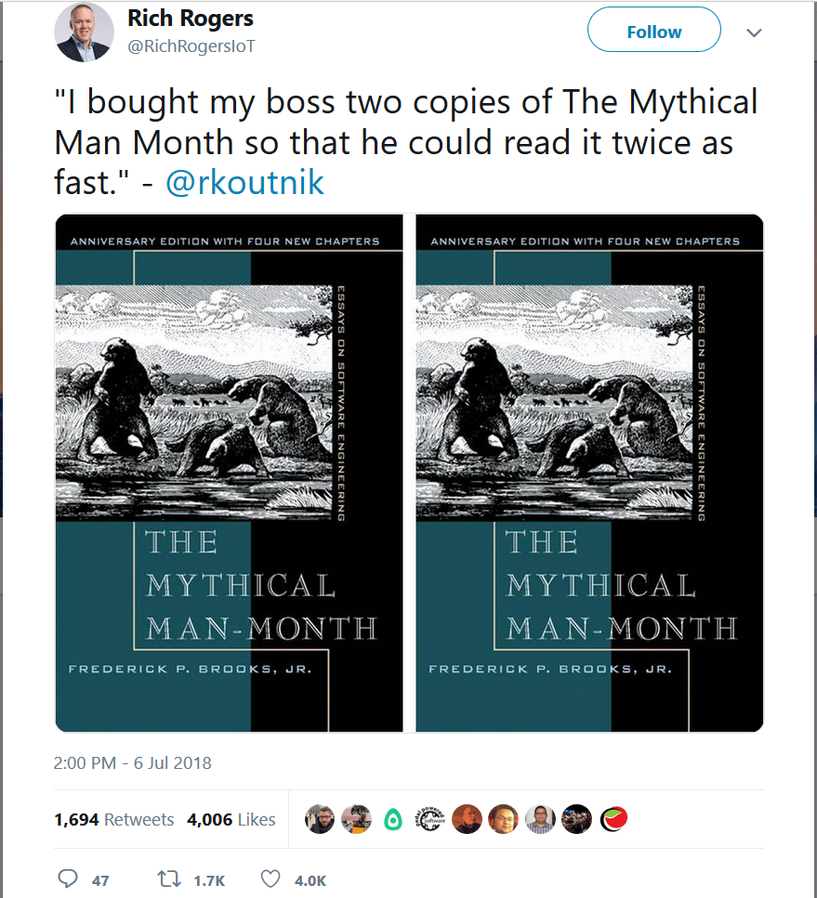

Slide 84
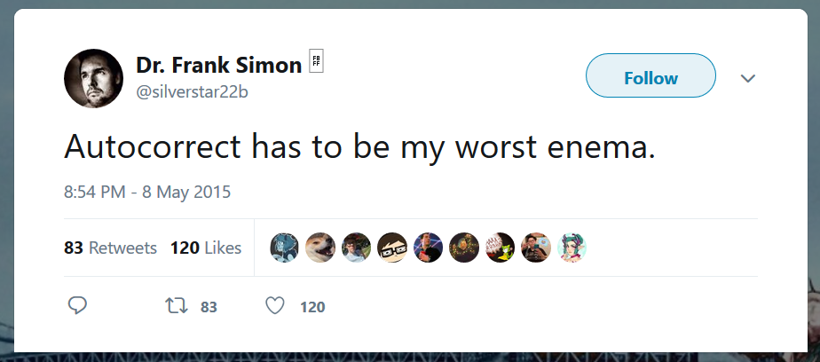

Slide 85
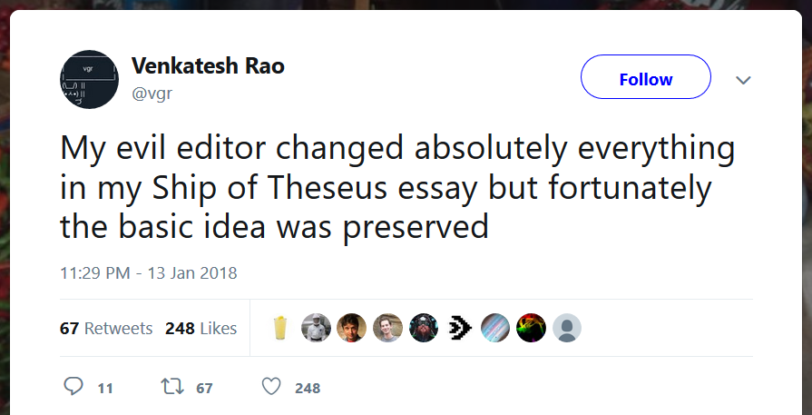

Slide 86
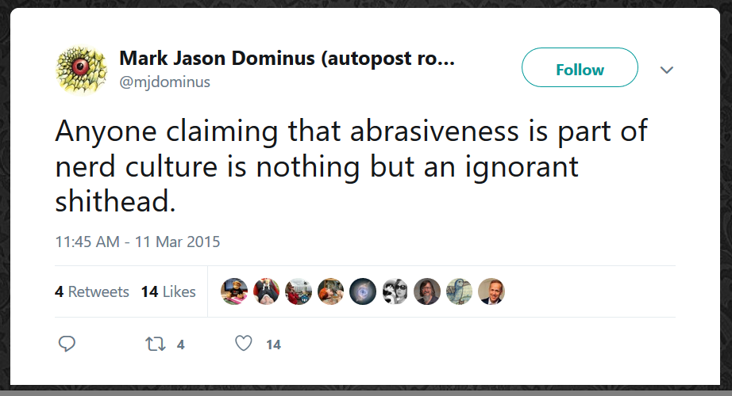

Slide 87
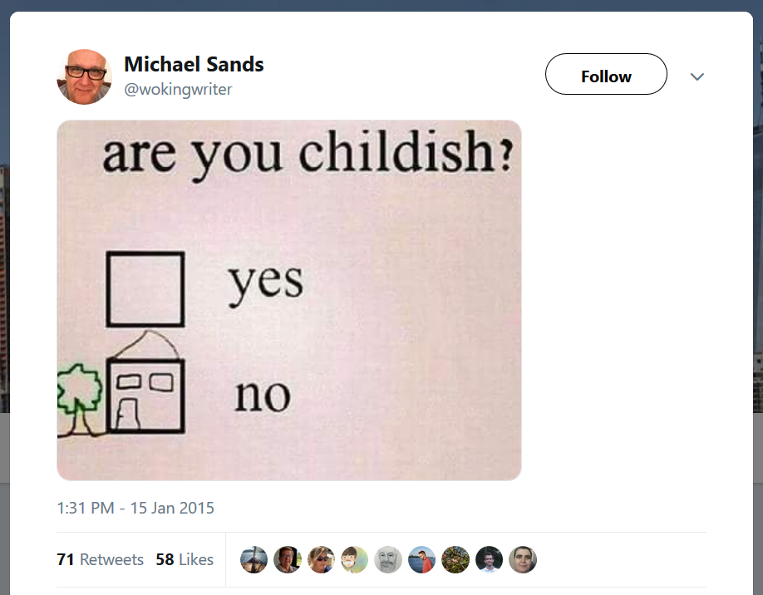

Slide 88
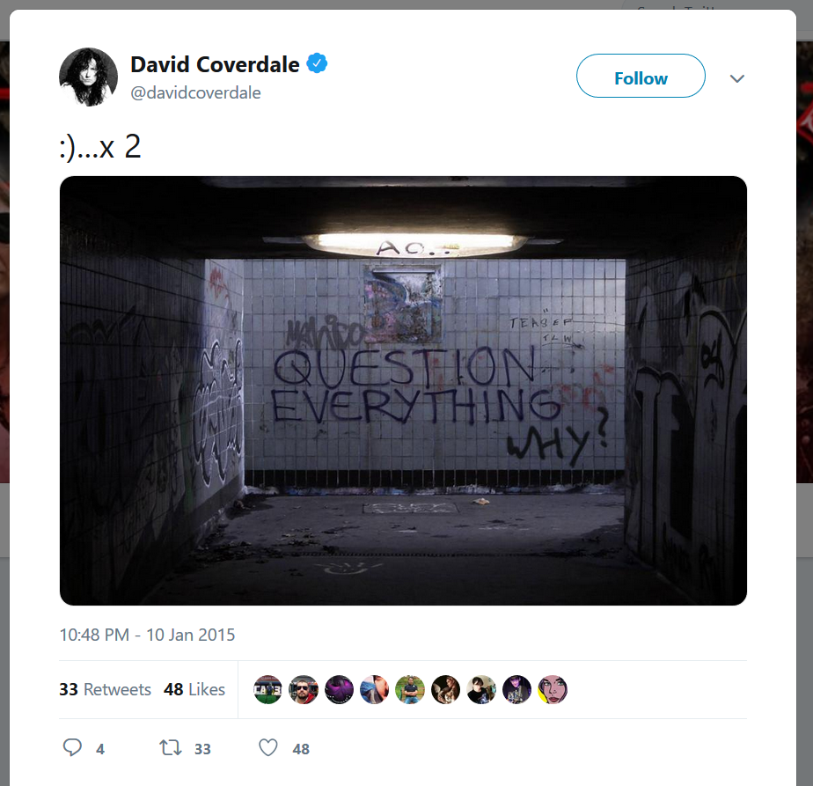
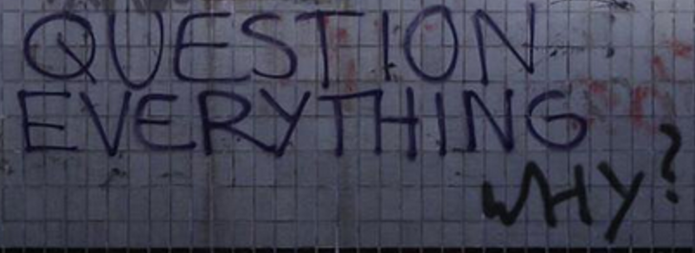

Slide 89
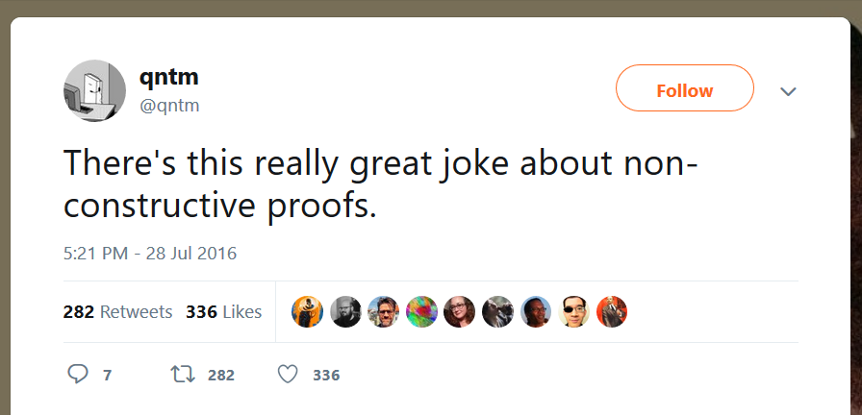

Slide 90
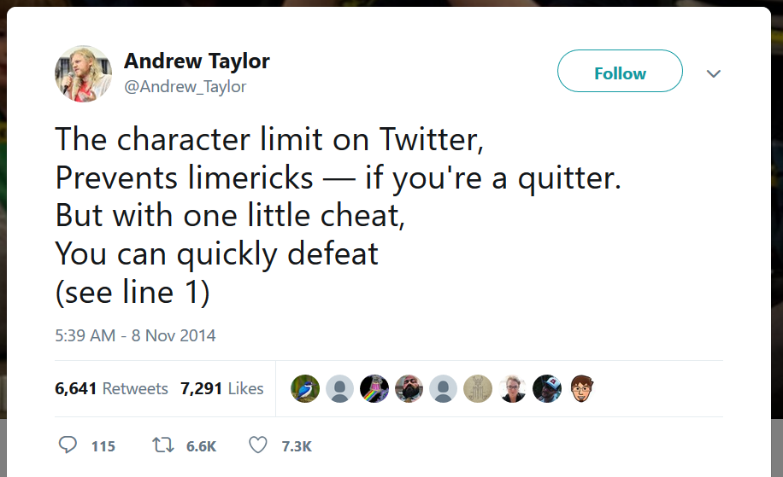

Slide 91
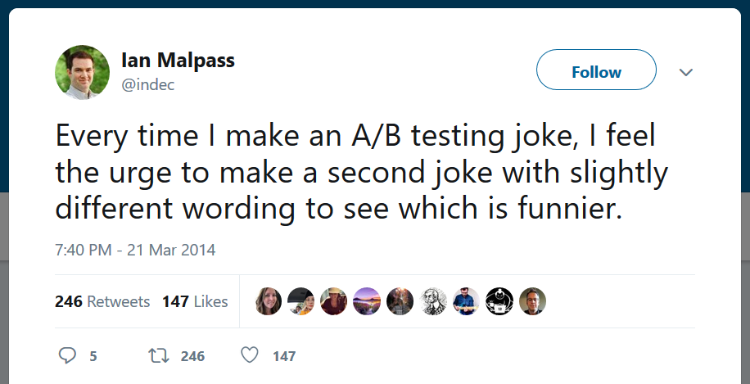

Slide 92
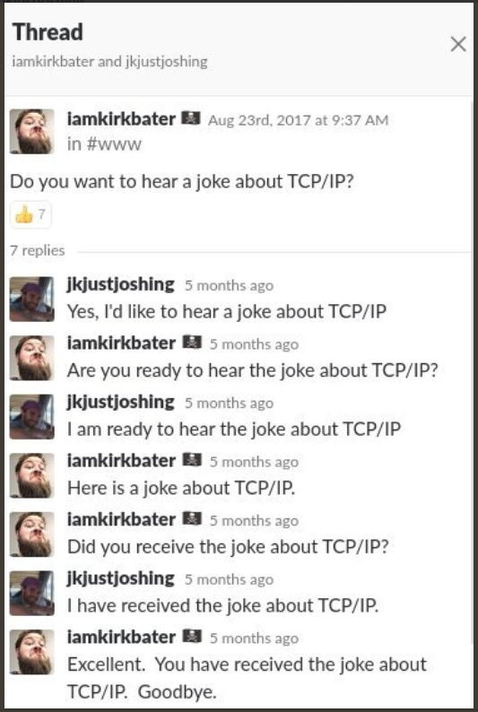

Slide 93
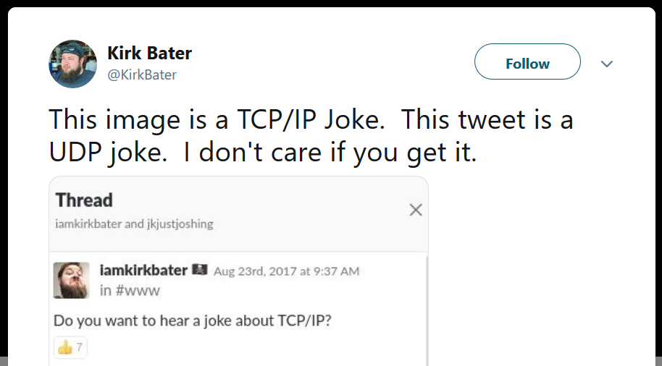

Slide 94
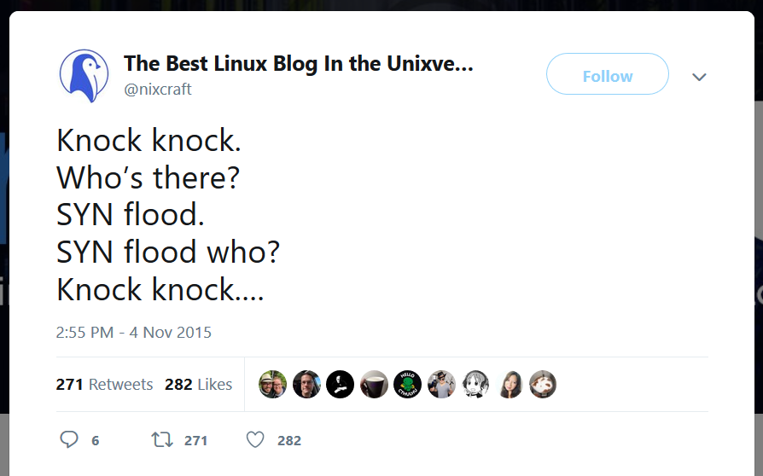

Slide 95
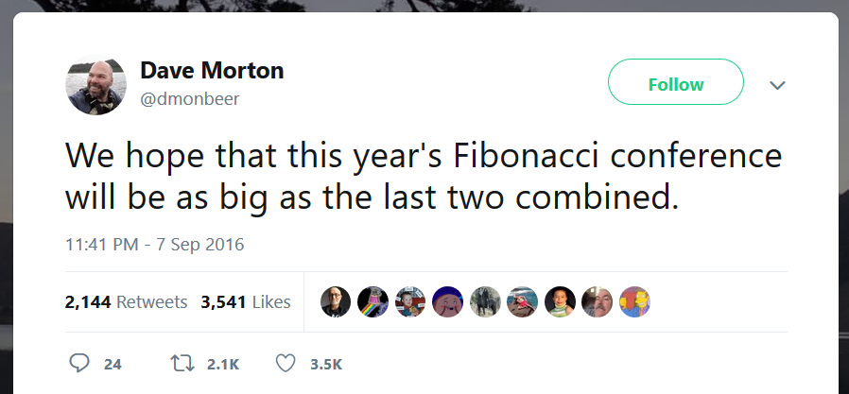

Slide 96


Slide 97
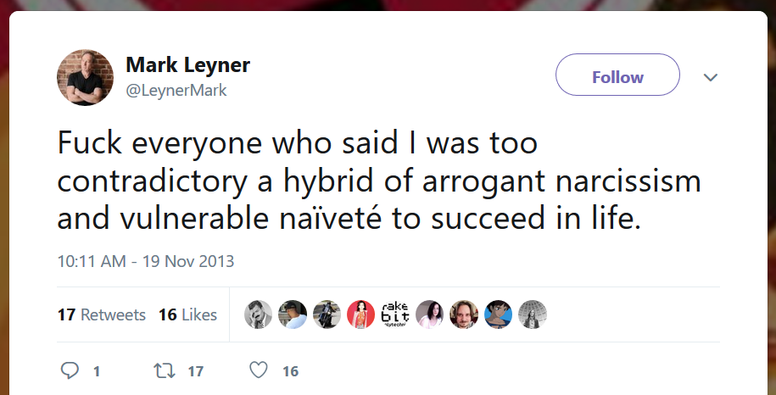


Slide 98
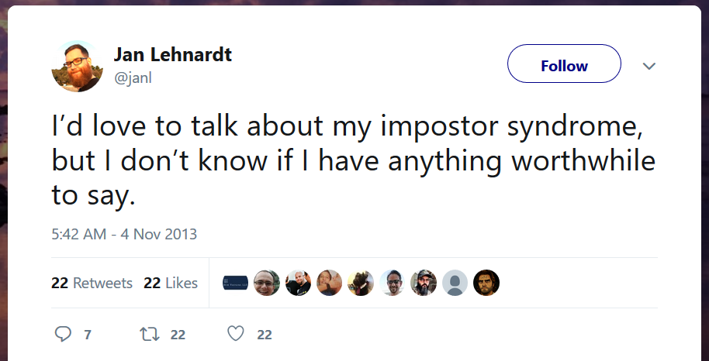

Slide 99
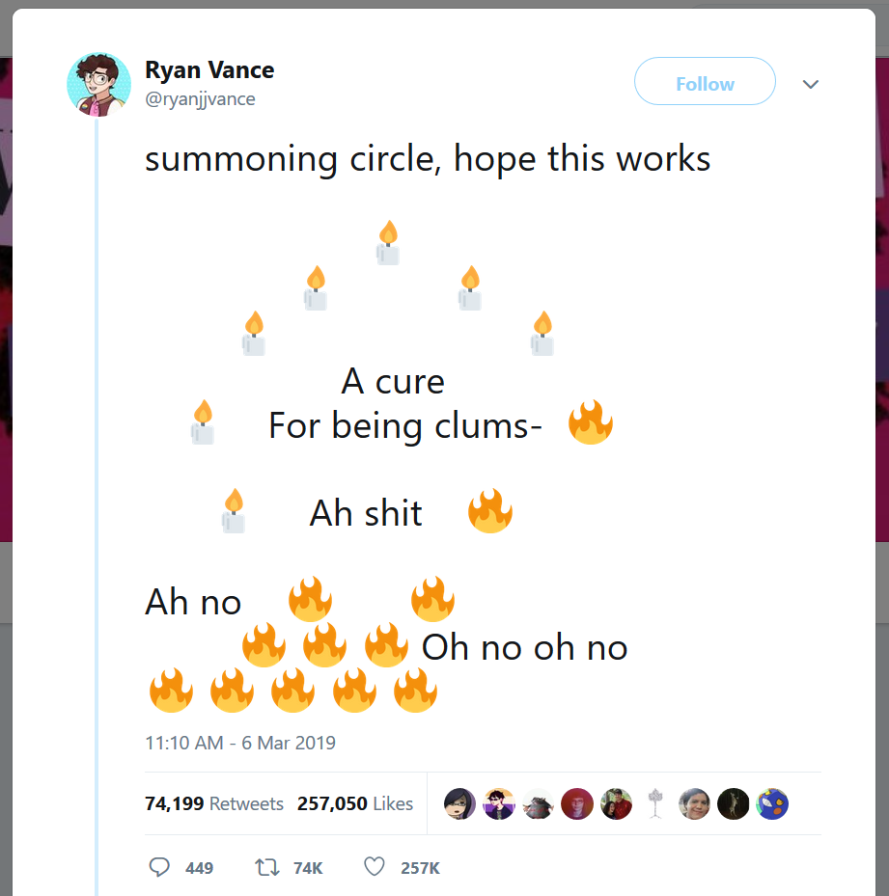

Slide 100
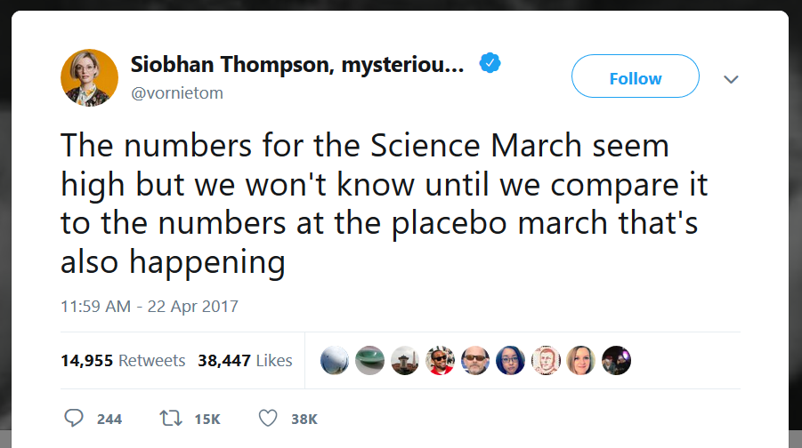

Slide 101
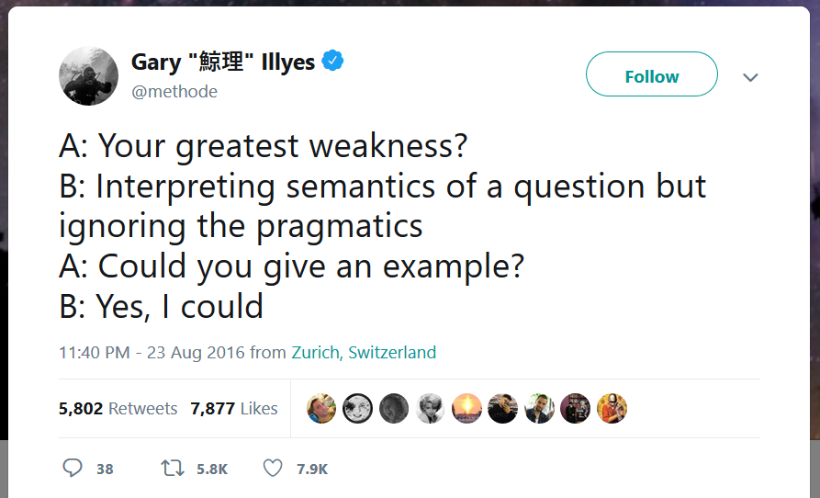

Slide 102
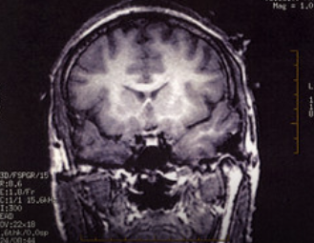
The point?
None, really…
…except, there seems to be a real connection between “decoding the pattern”, spotting an implicit connection between the constituents of the situation, and humor itself.
I dunno, I find that interesting. Very Gödelian.

Slide 103
Parsed macros
what the talk is really about

Slide 104
Three types of abstraction
Syntactic abstraction
Type abstraction
Functional abstraction

Slide 105
sawyerx said the syntax of Perl is very very very very flexible
Clearly, Perl 5 and Perl 6 are already turning syntax tweaking up to 11
My goal: turn it up to Inf
Not there yet
aka “vaporware”
But I have a concrete plan, and it seems feasible

Slide 106
Not everything looks like a function call
We’ve seen macro calls that look like function calls: moo()
Or like operators: value++
But… this is not enough. There’s also terms, statements, parameters, arguments, and weird-looking operators with special parsing
This requires… co-opting the parser
parse
optimize
generate

Slide 107
”But what about pluggable keywords?”
Things like Keyword::Simple on CPAN already do this
But even that is a subset of what I’m suggesting
What I’m suggesting: arbitrarily extend rules in the grammar, not just keywords/statements, but anything
This seems to be what the Apocalypses/Synopses are (implicitly) suggesting

Slide 108
unless (and until)
@parsed(/ "unless" <expr> <block> /)
macro statement:unless({ expr, block }) {
return quasi {
if !{{{expr}}} {
{{{block}}}
}
};
}

Slide 109
Reduce metaops
@parsed(/ "[" <infix> "]" /)
macro term:reduce({ infix }) {
my fn = infix.func;
return func(...values) {
values.reduce(fn);
}
}

Slide 110
Assignment metaops
problematic
@parsed(/ <infix> "=" <expr> /)
macro infix:<op=>({ infix, expr }, lhs) {
return quasi {
{{{lhs}}}
= {{{lhs}}} {{{Q.Infix @ infix}}} {{{expr}}};
};
}

Slide 111
The Great Filter, redux
Lisp-like macro expansion and Algol-like syntax seems like a great idea!
Almost an obvious one! Right?
So… where are all the Algoloids with macros?
I found three languages
Dylan
sweet.js
Julia

Slide 112
Macros that generate target code
@parsed(/ "if" <expr> <block> /)
macro statement:if({ expr, block }) {
my label = new Label {};
return asm {
jnz {{{label}}}
{{{block}}}
{{{label}}}
};
}

Slide 113
We now control the entire compiler
Slogan:
“Democratizing compiler writing”
parse
optimize
generate

Slide 114
End result: a truly extensible language
Perhaps more importantly: a language that’s not limited by what we know we need now
Allow for the necessary growth/adaption tomorrow
Doing this in a lexically scoped, modular, hygienic way
Will there be fragmentation? Yes.
But I think it’ll be “worth it” in terms of community utility
Fulfilling the promise of true Perl 6 extensibility

Slide 115
Goodbye 007
hello Alma

Slide 116
Thank you
questions, queries, qualms, quibbles?

